Slide 1
TMC-based Generalized Coastal Segmentation using DL model to fine tune
Responsibel by:
Zhen Tian
Notes:
This presentation outlines our implementation under the UGLA Demonstrator 3 for the TERRA project.
We focus on a hybrid offline–online Digital Twin framework that integrates coastal segmentation, key-variable prediction, and vegetation edge prediction, to support dynamic coastal monitoring.

Slide 2
Objective
Develop an intelligent and generalized coastal monitoring system that combines classical computer vision techniques (TMC) with deep learning (DL) to automatically detect and track shoreline boundaries from satellite imagery.
The areas are generalizable from St. Andrews to other areas in UK.
Notes:
Here is the structure of our Digital Twin system.
The inputs are originally from the public dataset including Landsat 7/8 costline detection, ISTAND82 for key variable predictions, and the sentinel-2 for vegetation egde predictions
The inputs will be pre-pocessed by Terra service to filter the noises and also store its data as sequencial format.
Later the pre-processed data will be fed into the offline models, each time the most recent model will be download from Terra platform, which was loaded on Terra last time.
Offline models are trained and re-trained with historical data, and periodically synced with online modules.
Online services handle user queries for segmentation and forecasting through cloud-based APIs.
Finally, the matched segmentations/ key variable predicitons or vegetation edge predictions would be generated based on user’s request.

Slide 3
Core Challenges
Parameter sensitivity: Traditional TMC methods require manual parameter tuning for different conditions.
Multi-class segmentation: Need to distinguish between sea, vegetation, and shoreline boundaries.
Computational efficiency: Real-time processing requirements for monitoring applications requires the training or re-training time not long.

Slide 4
Core Challenges
Parameter sensitivity: Traditional TMC methods require manual parameter tuning for different conditions.
Multi-class segmentation: Need to distinguish between sea, vegetation, and shoreline boundaries.
Computational efficiency: Real-time processing requirements for monitoring applications requires the training or re-training time not long.

Slide 5
Proposed Solution Architecture - CDT
CNN Feature Extraction ( suitable for catching images features).
DQN Parameter Optimization (Suitable for fine-tuning TMC’s parameters in loop).
TMC Segmentation (Suitable for giving a base capability to segment the coastline).

Slide 6
Why Choose DQN
The TMC parameter optimization problem exhibits several key characteristics that make it particularly well-suited for DQN approaches:
TMC parameter optimization is inherently a sequential decision-making problem:
-- Each parameter adjustment affects the optimal choice for subsequent adjustments
-- The order of parameter modifications influences the final outcome

Slide 7
Why Choose DQN
TMC parameters exhibit non-linear interdependencies
Context dependency: Optimal parameters vary with image characteristics
Non-convex parameter space: Multiple local optima

Slide 8
Why Choose DQN
DQN addresses these challenges through:
-- Neural network approximation: Captures complex parameter relationships
-- Experience replay: Learns from diverse parameter combinations
-- Exploration strategy: Avoids local optima through ϵ-greedy policy

Slide 9
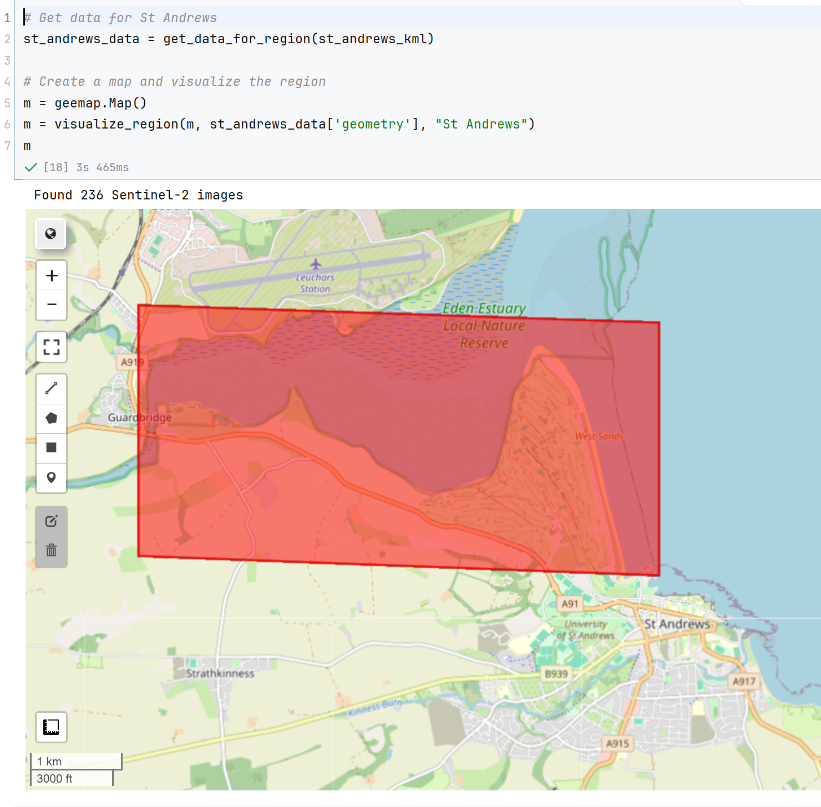
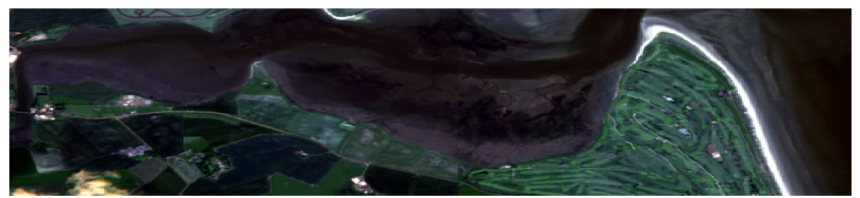
Input Data Specification
Data Source: Setenel-2 Dataset
Area: St. Andrews
Duration: 2017 - 2024
Cloud filtering : No any
clouds from eyesight

Slide 10
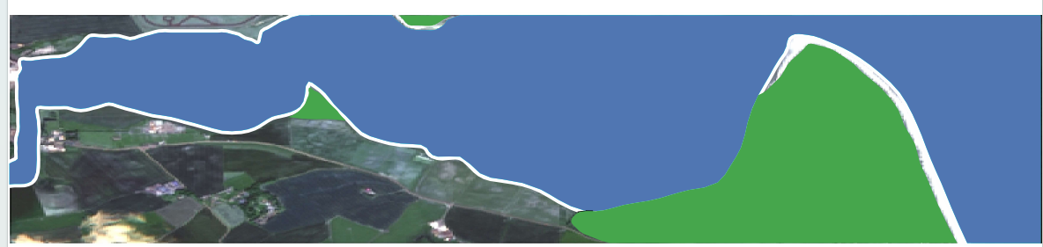
Ground Truth Labeling Protocol
Sea Areas (Blue) - represents water bodies
Vegetation Areas (Green) - represents land vegetation
Shoreline Boundary (White)- exact water-land interface
Mixed Areas: Unlabeled - residential/urban areas mixed with vegetation
Water Body
Shoreline Boundary
Vegetation Areas

Slide 11
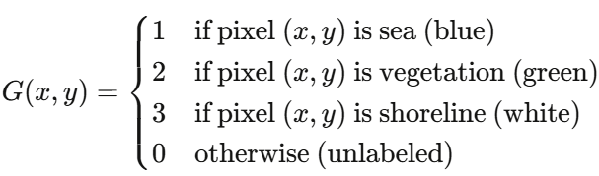
Mathematical Representation

Slide 12
TDC Structure
Action Space: Decrease/Keep/Add low-thres value, D/K/A high thres value, ...
CNN Recomended Para
DQN Recomended
TMC Parameter
TMC
Select Properly
DQN Reward Function
Setenel-2 Image
CNN’s Selected TMC Parameter From Completed Satge 1
Setenel-2 Image
DQN Reward
Function
Current Feature Vectors
Segment Result Compare with GroundTruth
DQN Network Parameters Update
DQN Update (Stage 2)
CNN Recomended
TMC Parameter
TMC
CNN Backbone Layer
Feature Map
Parameter Prediction Newtwork
Setenel-2 Image
CNN Loss Function
CNN Network Parameters Update
Segment Result Compare with GroundTruth
CNN Update (Stage 1)

Slide 13
Explanation for the TDC
We have two stages for training CNN and DQN, respectively
CNN: is focused on giving the TMC recomended parameters with a good base values.
DQN: is focused on fine-tuning the TMC parameters by using detailed action space, and fine-designed reward function for the final perfect segmentation performance.

Slide 14
CNN Backbone Features
The CNNcomponent utilizes a ResNet-50 architecture as the backbone feature extractor.
Data Type Float32, normalized to [0,1] (much precise)
Batch Size 16
Feature Dimension 2048 (after global average pooling)

Slide 15
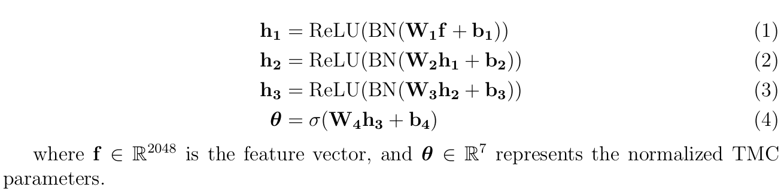
Parameter Prediction Network
The parameter prediction network consists of three fully connected layers with batch normalization and dropout for regularization:

Slide 16
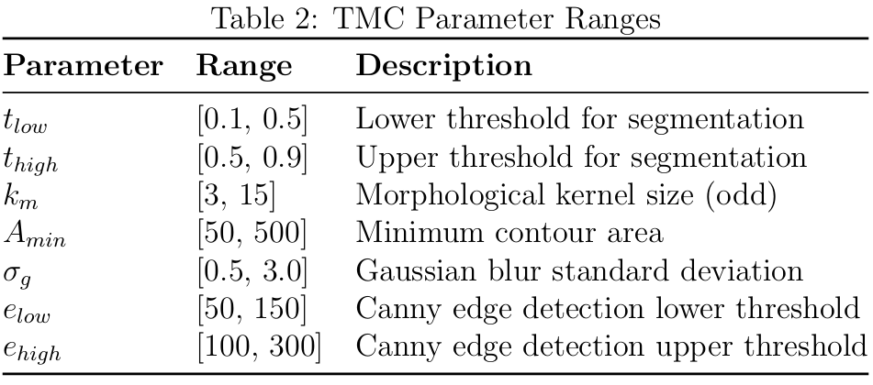
TMC Parameter Mapping

Slide 17
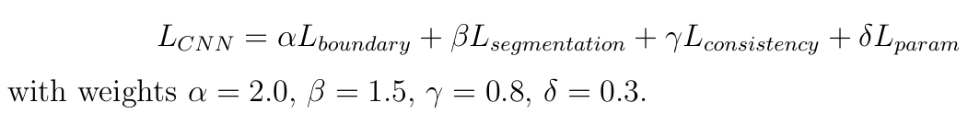
CNN Loss Function Design
The CNN training employs a multi-objective loss function combining four components:

Slide 18
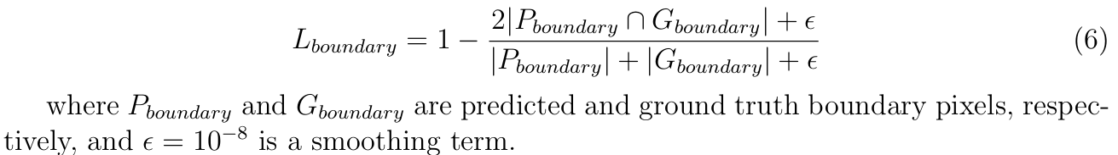
Boundary Detection Loss
The boundary loss uses Dice coefficient to measure shoreline detection accuracy:

Slide 19
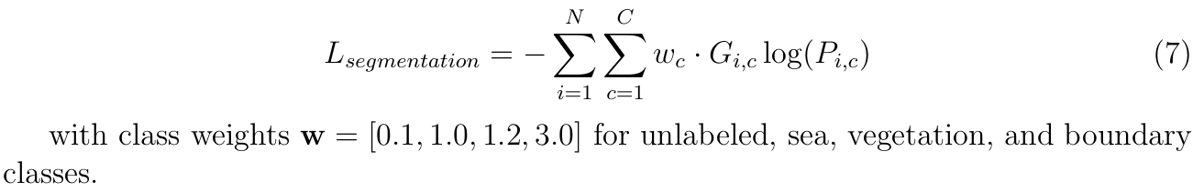
Segmentation Loss
The segmentation loss employs weighted cross-entropy to handle class imbalance:
i is pixels with 512 x 512, c is categories with sea, landline, vegetation, and unlabelled, P is the predictive catagory probability, G is the real catagory capability

Slide 20
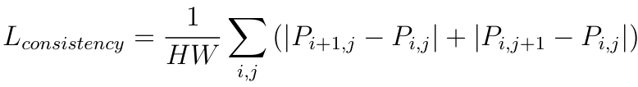
Consistency Loss
Spatial consistency is enforced through gradient regularization:
H is pixel row number, j is pixel column number, i is the ith row, j is jth column.

Slide 21
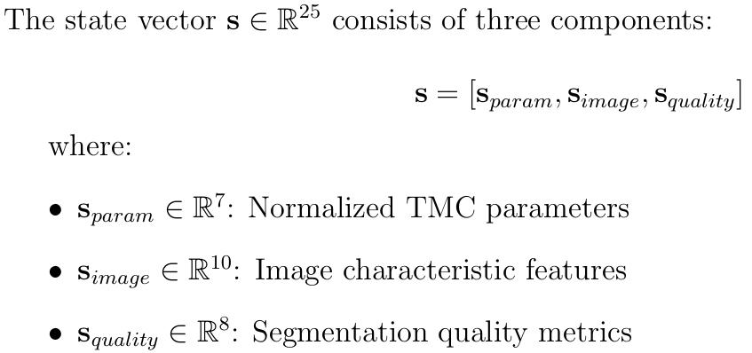
DQN Features
State Space Definition

Slide 22
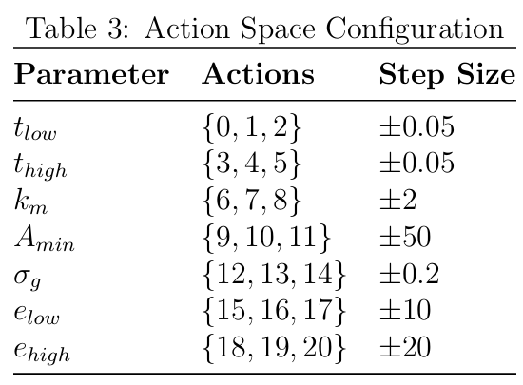
Action Space Encoding
The action space consists of 21 discrete actions encoding parameter adjustments:

Slide 23
Image Characteristic Features
Mean Intensity
Intensity Standard Deviation
Edge Density
25th Percentile Intensity
75th Percentile Intensity
Horizontal Gradient Mean
Vertical Gradient Mean
Aspect Ratio
High Intensity Pixel Ratio
Texture Complexity

Slide 24
Quality Metrics
Boundary IoU
Segmentation Accuracy
Boundary Smoothness
Region Connectivity
Signal-to-Noise Ratio
Temporal Consistency
Noise Level
Processing Efficiency

Slide 25
DQN Reward Function
The reward function combines multiple objectives to balance segmentation quality and computational efficiency:

Slide 26
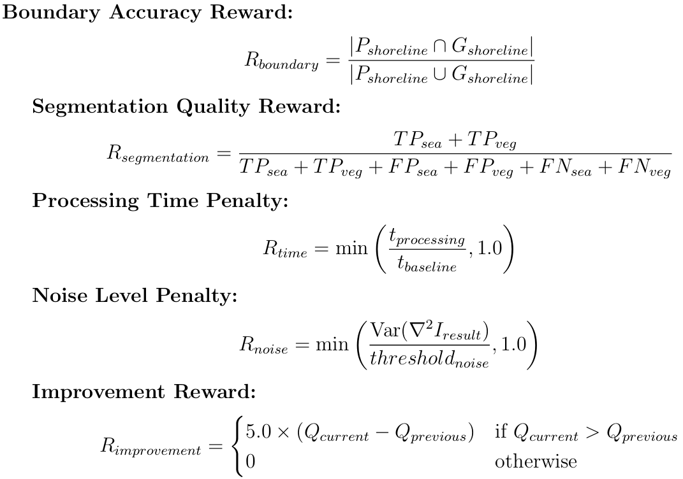
Reward Components
defcalculate_quality_score(segmentation_result, ground_truth):
boundary_iou = calculate_boundary_iou(segmentation_result, ground_truth) seg_accuracy = calculate_segmentation_accuracy(segmentation_result, ground_truth) boundary_smooth = calculate_boundary_smoothness(segmentation_result) region_connect = calculate_region_connectivity(segmentation_result) noise_level = calculate_noise_level(segmentation_result) Q =(0.35* boundary_iou + 0.25* seg_accuracy + 0.20* boundary_smooth + 0.15* region_connect + 0.05*(1- noise_level)) return Q defcalculate_improvement_reward(Q_current, Q_previous): if Q_current > Q_previous:return5.0*(Q_current - Q_previous)else:return0.0

Slide 27
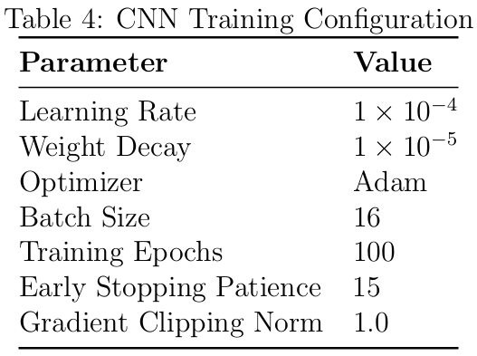
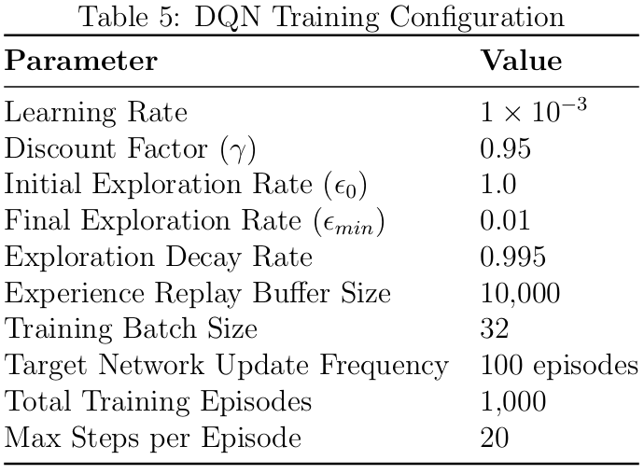
Configuration Parameters

Slide 28
What for Next Step
1. Completing the Re-labelling
- complete the re-labelling from 2017-2025
- use these re-labelling data as the ground truth
2. Build the code
- Design this two-stage DCT in python
- prepare images from the other areas ( apart from St. Andrews) to verify the generalization capability.
3. Test baed on the St. Andrews data
- Current DCT is required to verify its segmentation capability on initial area.
- Give the proper accessment to the segmentation results over the ground truth once the training is completed.
4. Potential Fine-tune for DCT
- Once the DQN’s fine-tune is not satisfied on St. Andrews, prepare other constructive mechanisms to assist DQN.
- Once the DCT’s generalization capability is not satisfied on other areas, find some additional mechanisms to assist to maintain the generalization capability.
Notes:
Next, we aim to modularize TMC as a Terra microservice more tightly, improve noise filtering quality,
support more complex shoreline/vegetation classification, and develop a TMC-AI hybrid model for better adaptability and accuracy.

